Slide 1
Project Red Talon
Preventing STDs and HIV among Tribes in
Oregon, Washington, and Idaho.
Northwest Portland Area
Indian Health Board

Slide 2



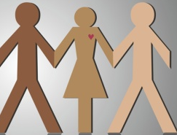
Project Red Talon: Four Objectives
Increase Capacity to Prevent STDs
Increase Awareness about STDs
Improve AI/AN Representation
Improve Testing & Treatment

Slide 3
Cases per 100,000

Slide 4
New AI/AN HIV Diagnoses - 2005

Slide 5

Copyright © 2001-2004 Campaign for Our Children

Slide 6
STD: Transmission
Skin-to-Skin Contact
Sexual Fluids
Ingest Fecal Material

Slide 7
Most Infections are Silent!
Most STDs do not produce noticeable signs or symptoms.
75% of women and 50% of men with chlamydia have no signs or symptoms.

Slide 8
NW Rates: Youth Impact
In the Northwest, over 700 Native youths age 10-24 years were diagnosed with chlamydia in 2009.

Slide 9
Are STDs Serious?
Yes. STDs are the most preventable cause of infertility in the U.S.
Without treatment, chlamydia and gonorrhea can cause permanent damage to the reproductive organs.

Slide 10


Slide 11
Project Red Talon
What’s New?

Slide 13

We are the only comprehensive health resource for Native teens and young adults, providing content and stories
– for Native youth, by Native youth –
about the topics that matter most to them.
We strive to promote holistic health and positive growth in our local communities and nation at large.

Slide 14

Website: theory-based, offering culturally-appropriate health information, with tools for behavior change & positive youth development
Outreach:
  Text Messaging Service
  Facebook, Twitter… and more…
  Print materials and swag…

Slide 15
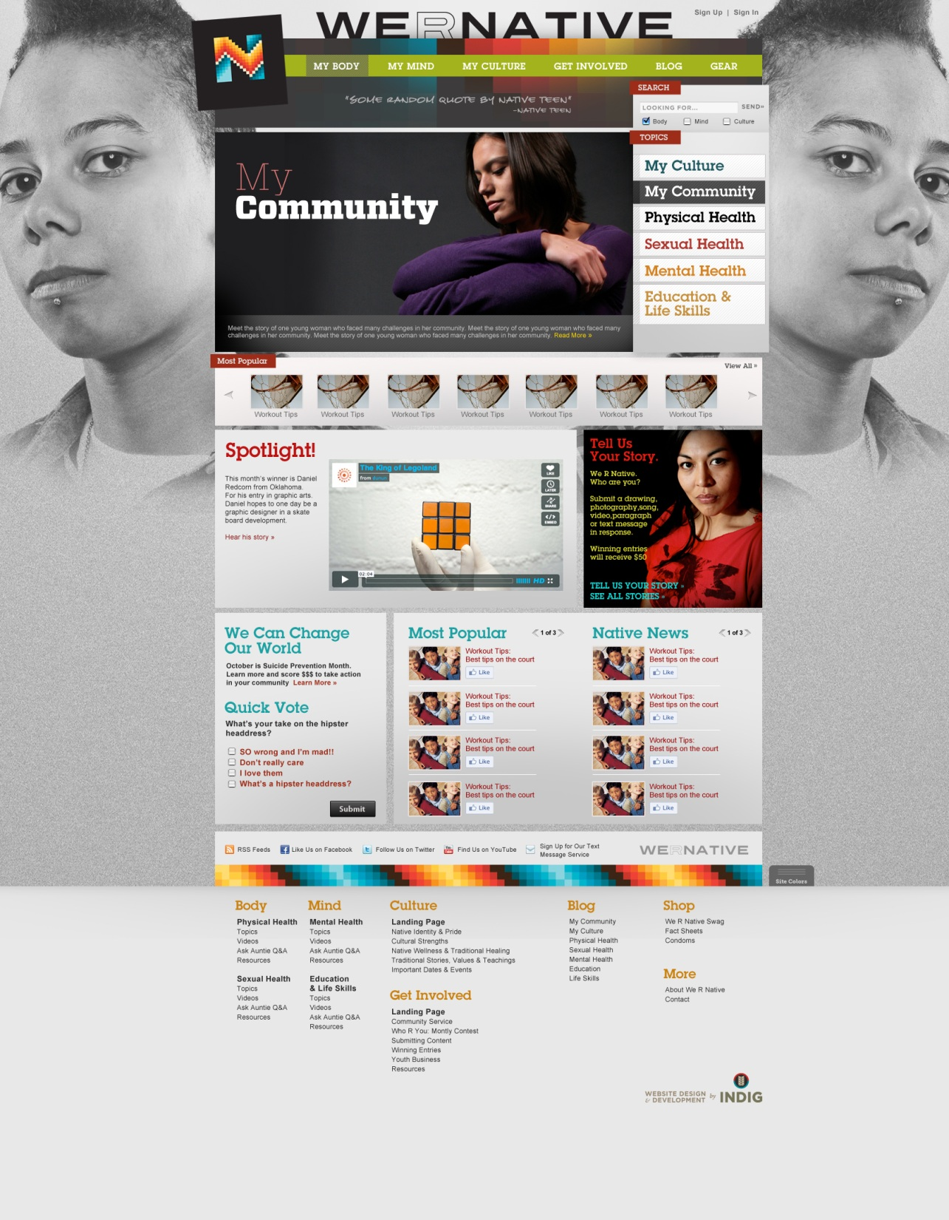
Notes:
The website, funded by the President’s National HIV/AIDS Strategy and the Indian Health Service’s National HIV/AIDS Program, will specifically target American Indian and Alaska Native teens and young adults. The site will address health and social issues important to Native youth, and will integrate other social marketing strategies like MySpace©, Facebook©, Twitter©, and text messaging.
Native youth, elders, and topical experts from throughout the U.S. will soon be sought to assist in the construction of the website, by becoming authors of blogs, directors of videos, graphic design artists, and more. A text messaging service is also being designed to support the website, send out periodic health tips, provide subscribers with updates on related contests and social service opportunities, and challenge youth to take a more active role in their personal health and wellbeing. Both services will be launched in 2011.

Slide 16
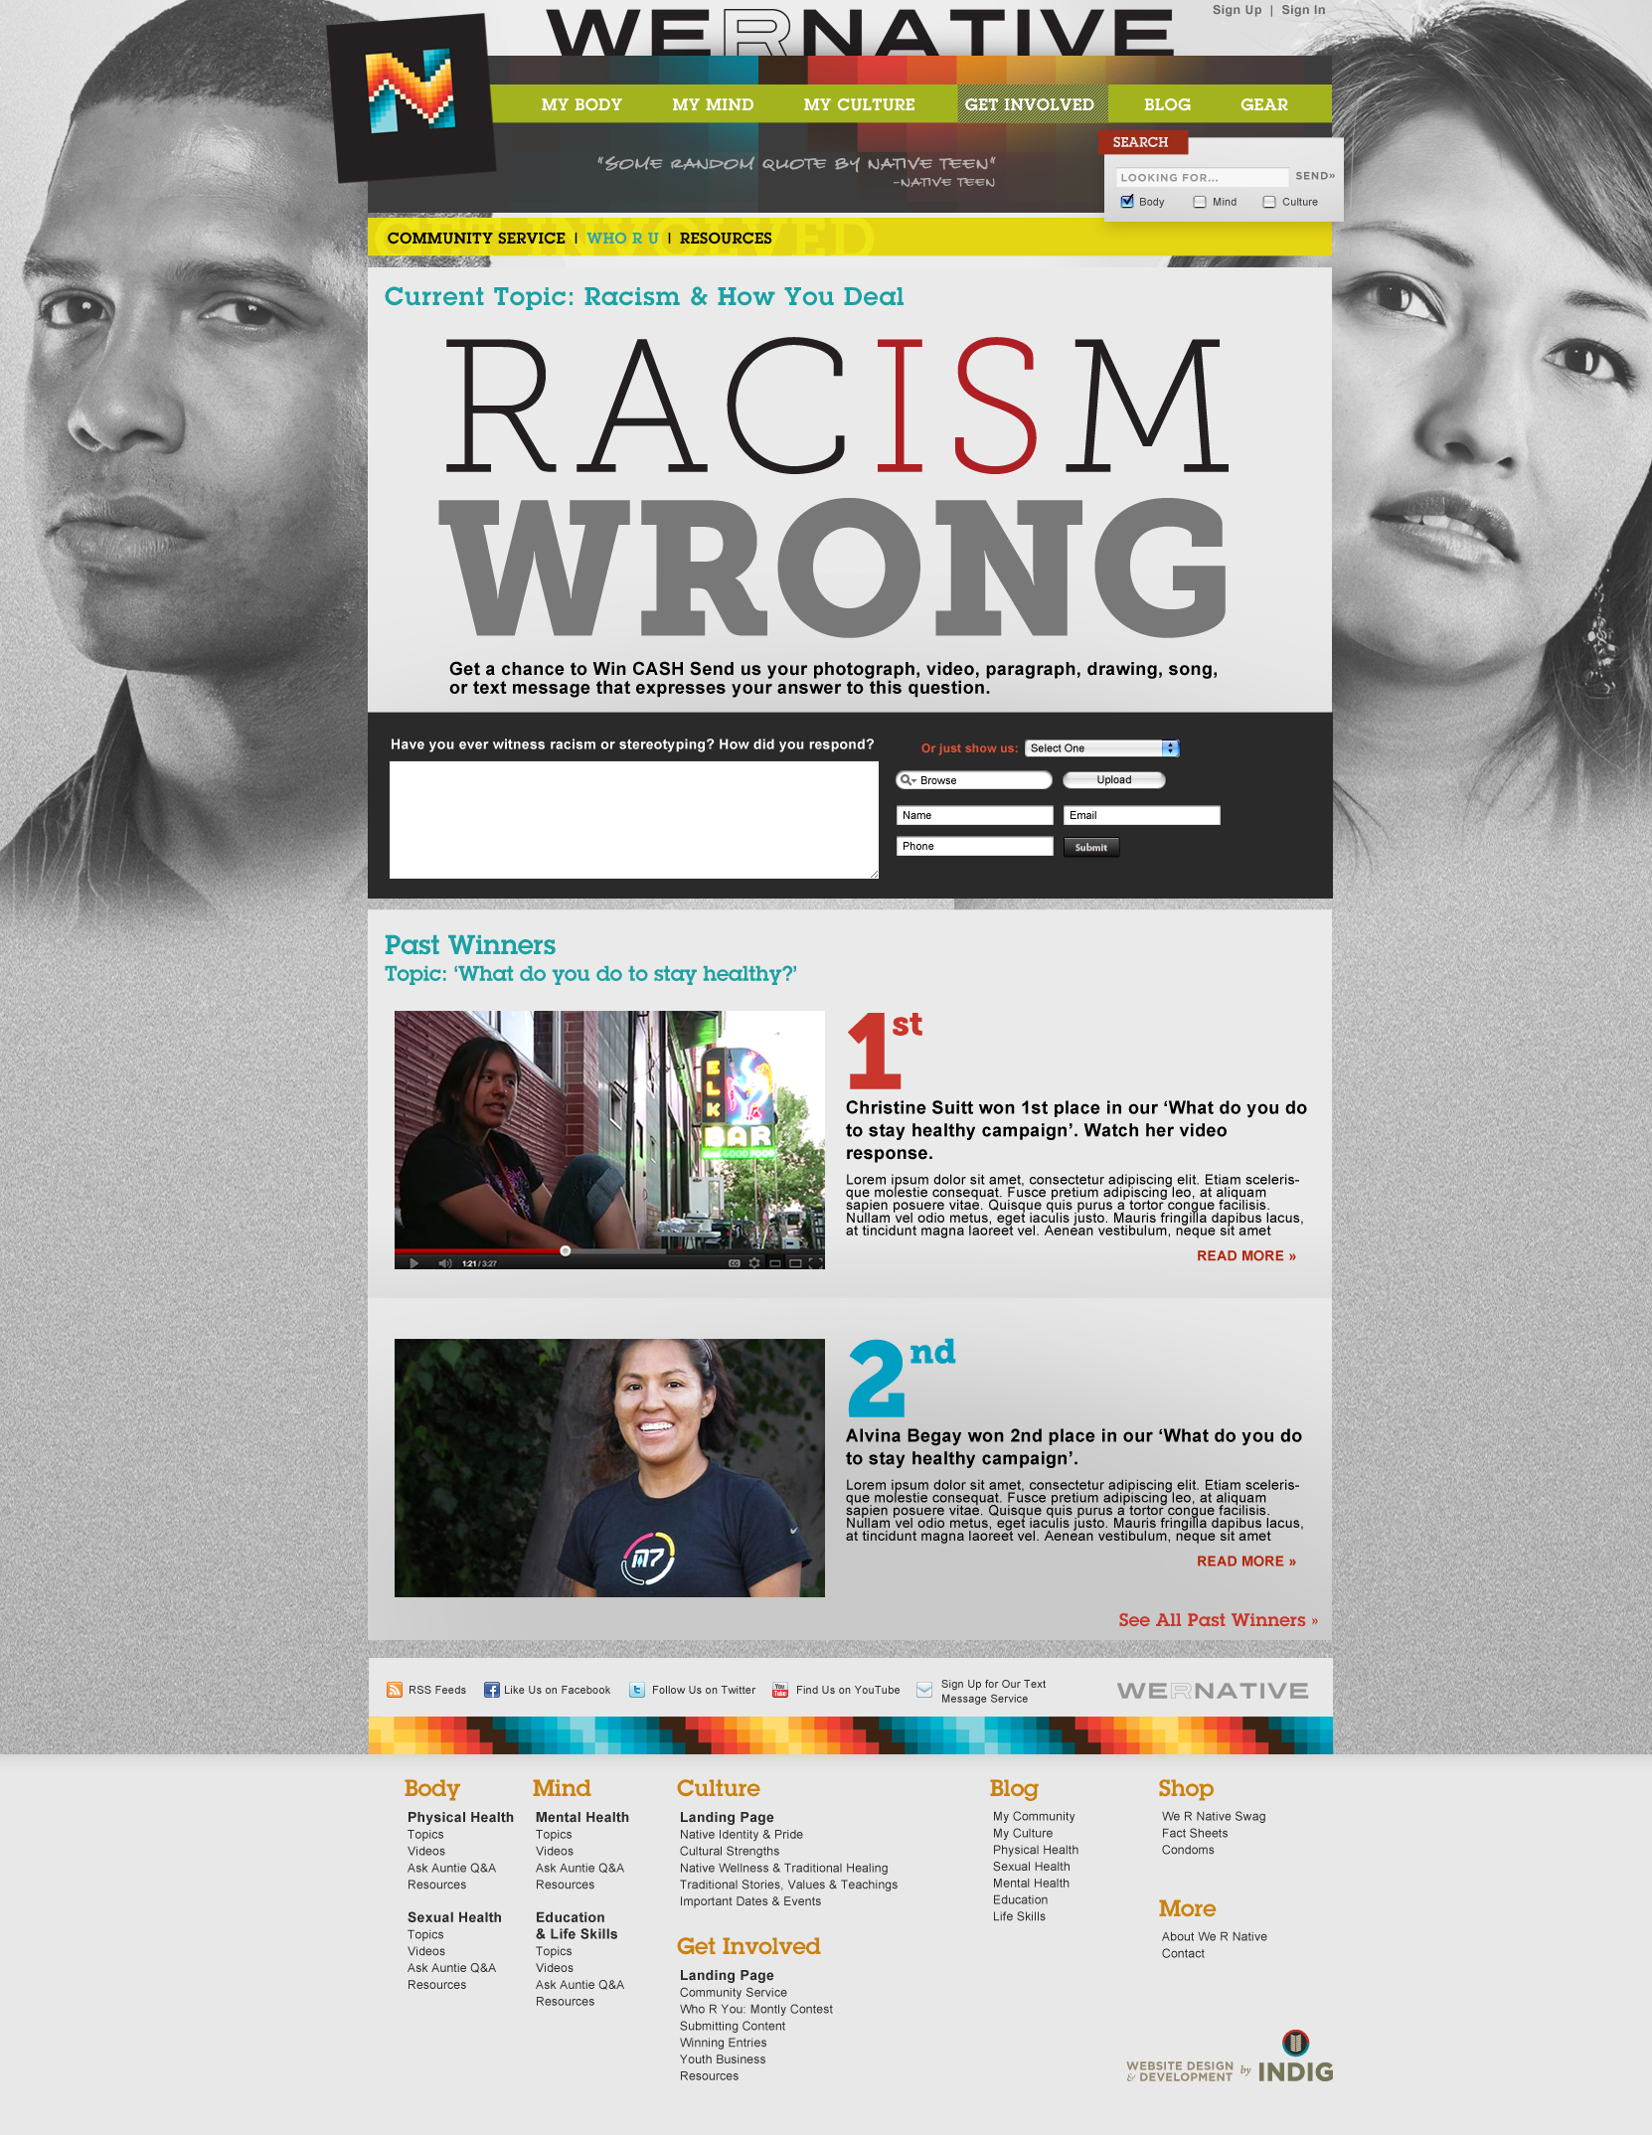

Slide 17
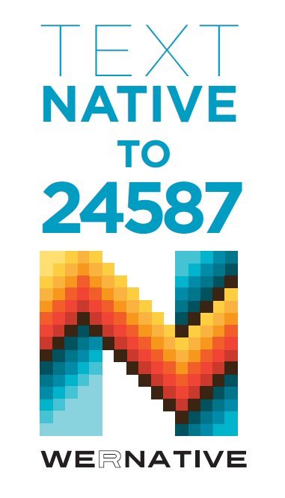
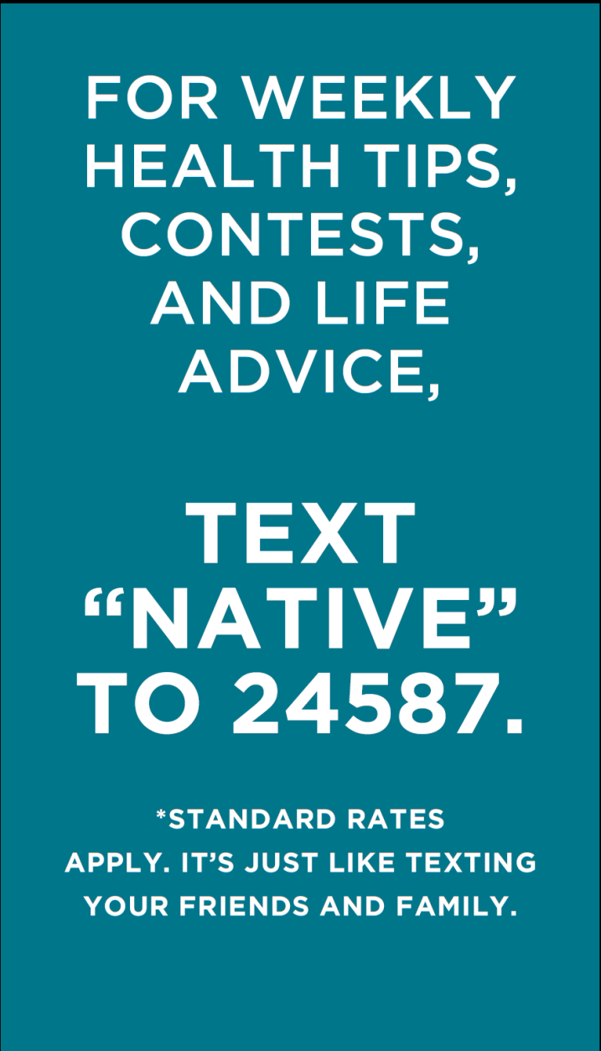

Slide 18
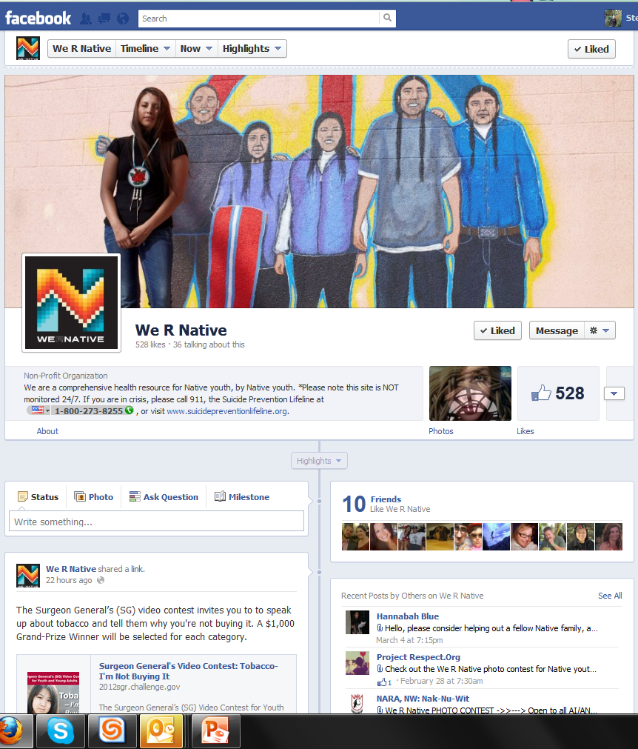

Slide 19
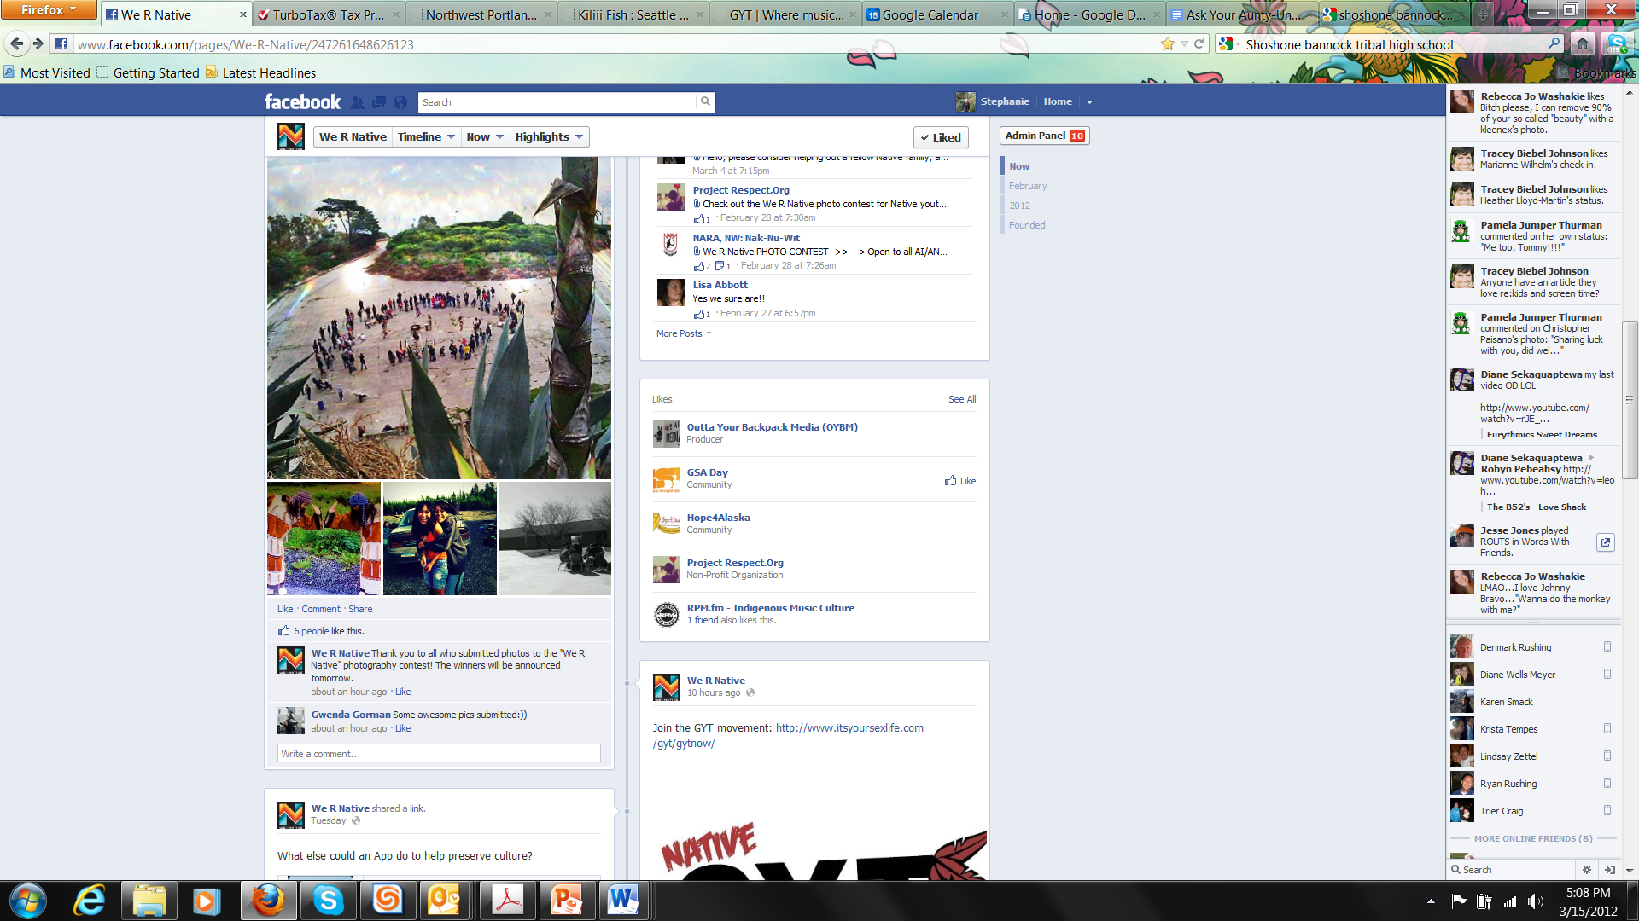

Slide 20
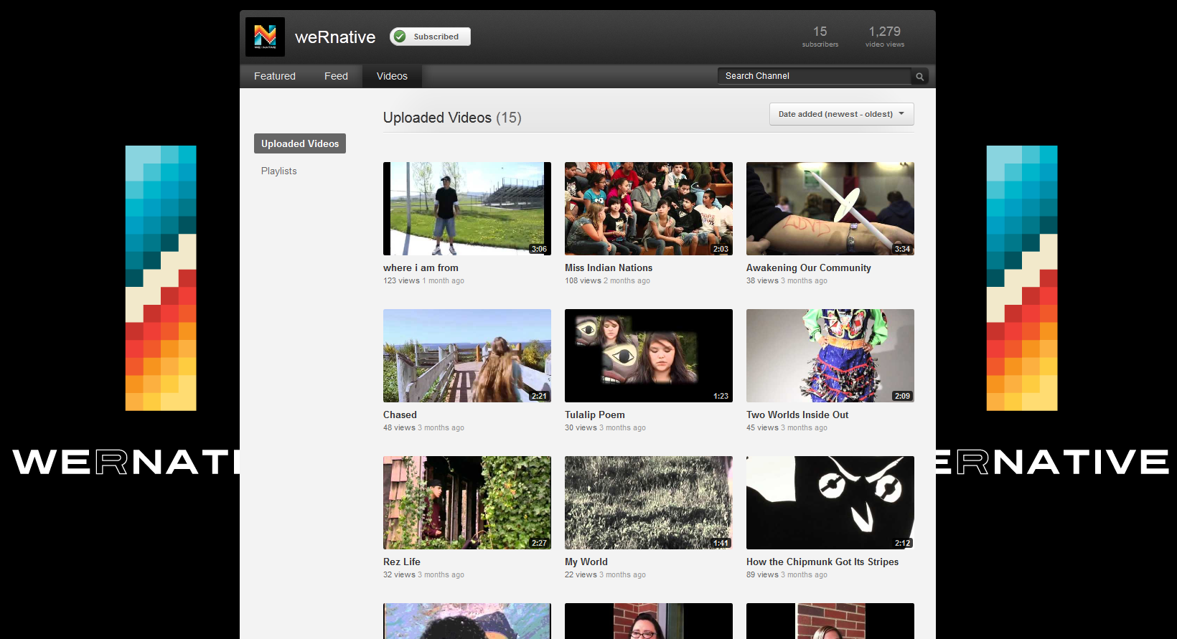

Slide 21

Native VOICES Project
Adapt a CDC evidence-based intervention,
VOICES, and evaluate its effectiveness
as a sexual health resource for Native teens and
young adults (15-24 years old) in the Pacific NW
Supported by a three-year grant from the Indian Health Service,
issued through their Native American Research Centers for Health (NARCH) program
Notes:
Give Stats – Over 50% of new STD infections in the US occur among young people 15-24 years old.
And AI/AN folks are disproportionately impacted by STDs. (2nd in CT and GC…can lead to infertility. AI/AN ranked 3rd highest in terms of HIV/AIDS)
Yet there are no CDC-recognized and promoted sexual health EBI for AI/AN…who is most affected? Our young people.
NWPAIHB is working to address this gap.

Slide 22
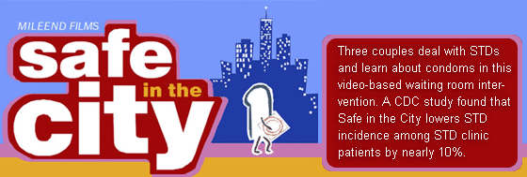
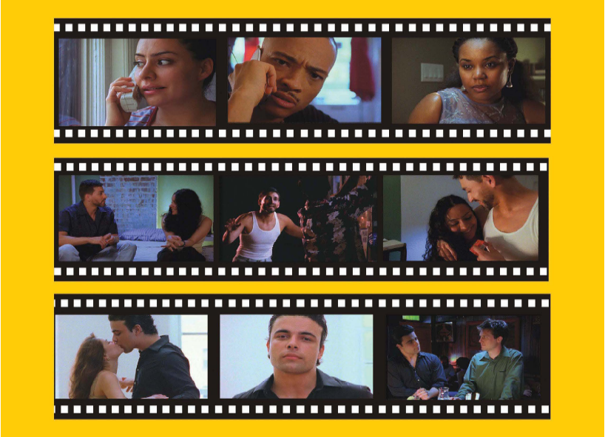

Slide 23
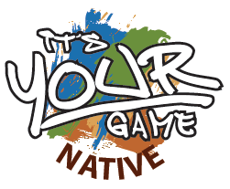
It’s Your Game…Keep It Real
Multimedia, healthy decision-making curricula for students in the 7th & 8th grade
Notes:
Theory-based – in Social Cognitive theory and models of social influence
Tortolero, SR, Markham, CM, Peskin, MF, Shegog, R, Addy, RC, Escobar-Chaves, SL, Baumler, ER. It's Your Game, Keep It Real: Delaying Sexual Behavior with an Effective Middle School Program. Journal of Adolescent Health. 2010; 46(2):169-179.
Theory-based, multimedia program for 7th & 8th grade
Two randomized controlled trials
Effective outcomes by follow-up at 9th grade
Delayed initiation of sexual intercourse
Reduced frequency of sex
Increased condom use
Positive impact on psychosocial variables

Slide 24
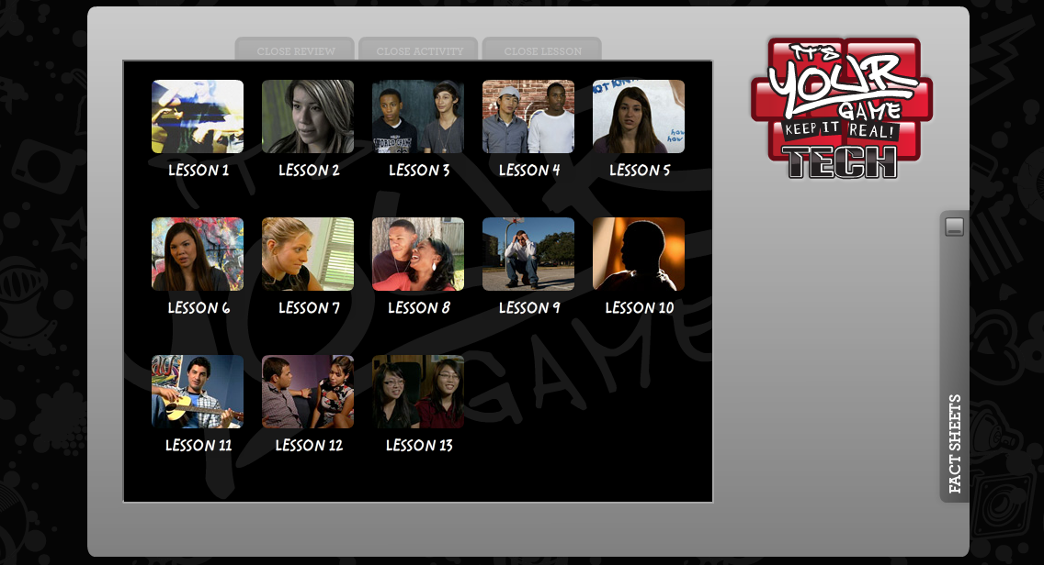
It’s Your Game
Notes:
Go to the link: http://iygtech.radiantexp.com/
Click on "I already have an account"
Enter username and password below:
Username: x999 (lowercase x)
Password: C0n$ultant (capital "C", 2nd character is a zero, and the 4th character is a dollar sign)

Slide 25
IYG Tech: Lessons & Topics
1 | Introduce IYG program; determine personal strengths
2 | Characteristics of healthy and unhealthy friendships
3 | Introduce “Select, Detect, Protect”: Identify personal rules & risky situations
4 | Characteristics of clearly saying “no” . Effective/ineffective refusal skills
5 | Anatomy, physiology, and reproduction
6 | Characteristics of health/unhealthy dating relationships; respecting others’ rules
7 | Social, emotional, physical consequences of sex; reasons to wait
8 | Communication & negotiation skills practice; Internet communication & safety
9 | Consequences of teen pregnancy
10 | Consequences of STI/HIV & the importance of testing
11 | Condom and contraception knowledge and skills
12 | “Select, Detect, Protect” review; condom negotiations
13 | Review of IYG; personalize reasons for not having sex
Notes:
IYG Tech is a 13-lesson, completely on-line version of IYG currently being evaluated in a randomized controlled trial in Houston, TX, funded by National Institute for Mental Health (NIMH) (Shegog & Peskin, Joint PIs).
It will form the basis for the IYG version that will be adapted for AI/AN youth in the current study.

Slide 26
Project Red Talon
Resources

Slide 27
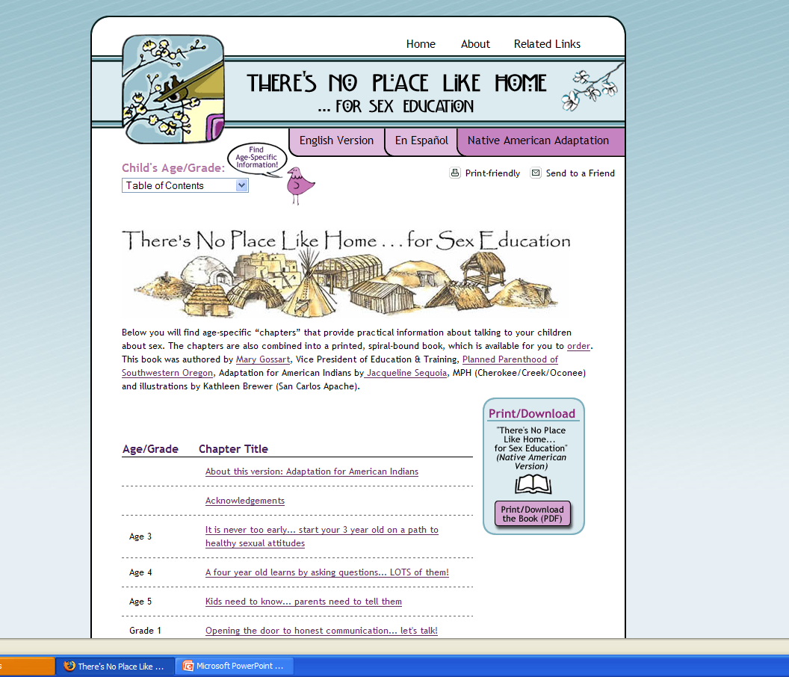
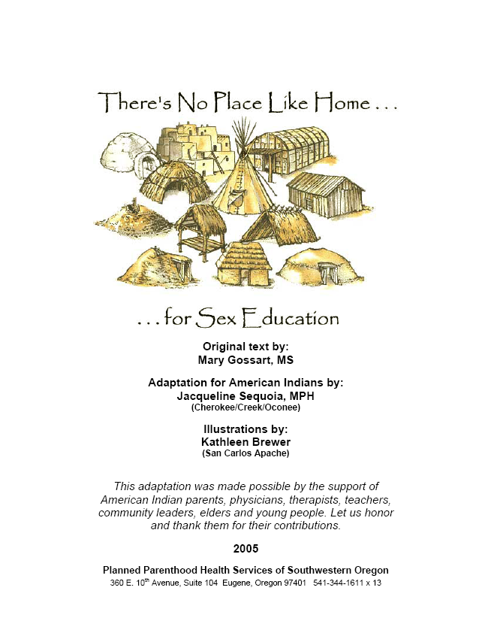
www.no placelike home.org/native american

Slide 28
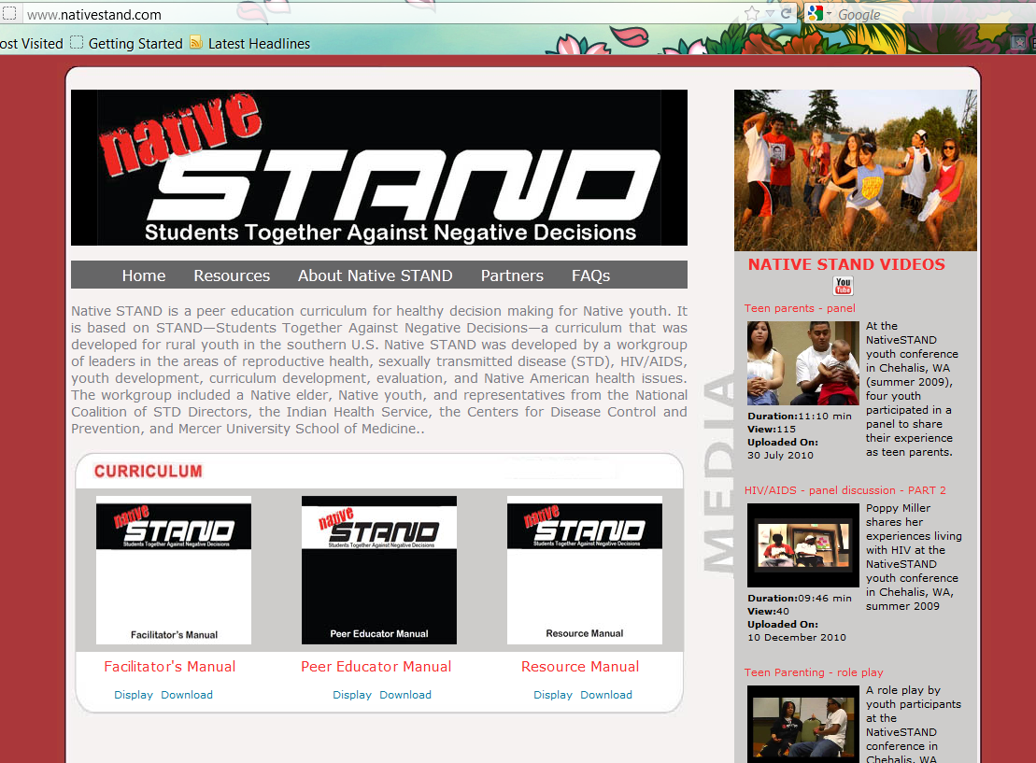

Slide 29

Youth Videos…
Healthy Relationships (4:15 min.)
Teen Sexual Health
Condom Demonstration
Teen Pregnancy and Parenting
Role Play: Once is Enough (3:19 min.)
Role Play: This Can’t Happen to Me (4:46 min.)
Living with HIV/AIDS (16:57 min.)
Drugs & Alcohol (6:20 min.)
Three student-developed Public Service Announcements (PSA) (3:59 min.)

Slide 30
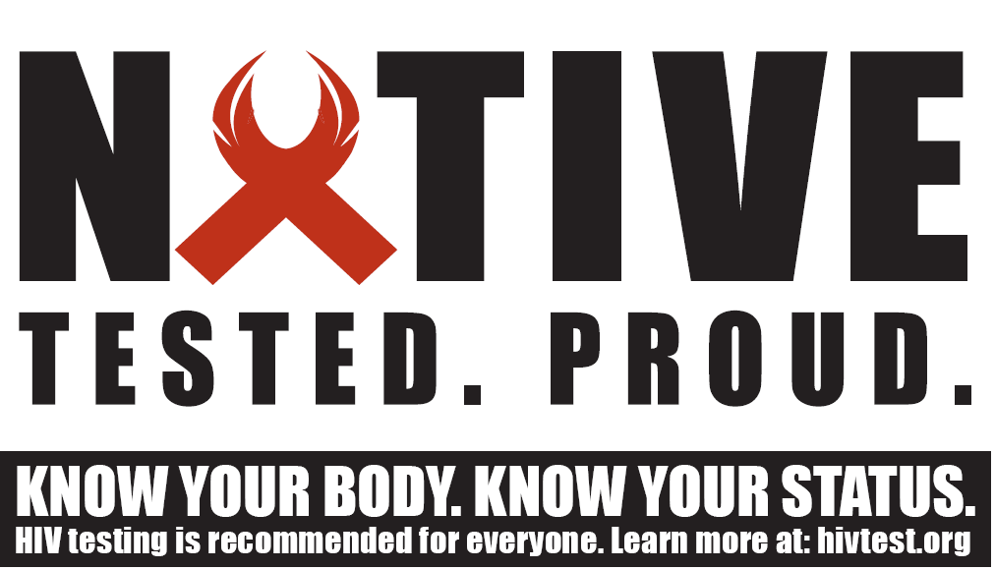

Slide 31
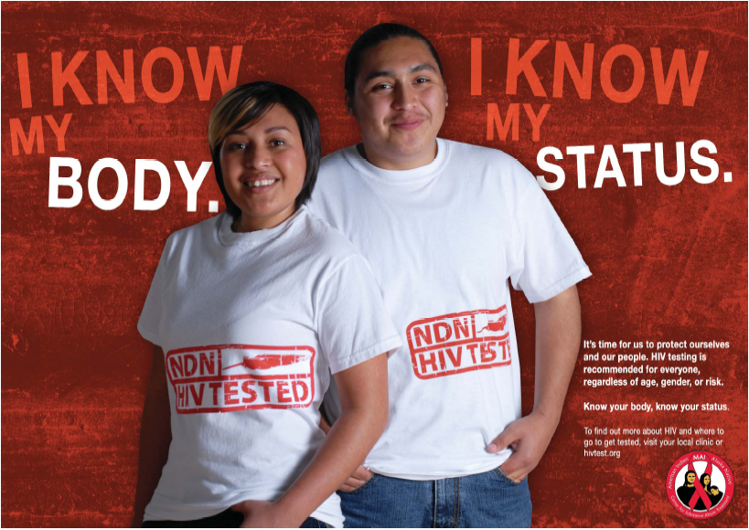

Slide 32
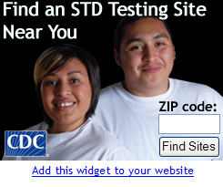
www.npaihb.org/epicenter/project/project_red_talon/

Slide 33
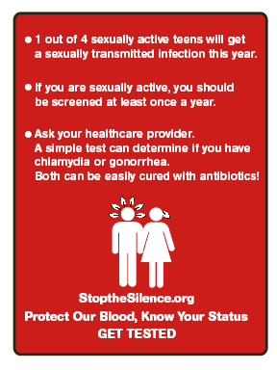
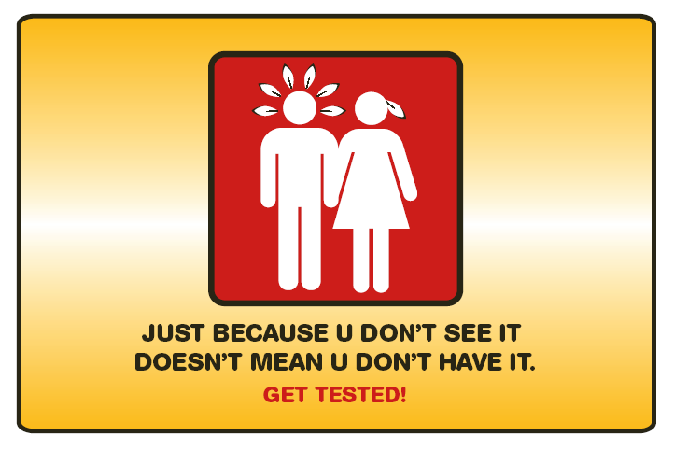

Slide 34
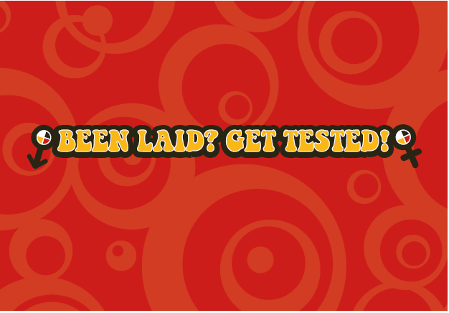

Slide 35
Questions?

Slide 36
Northwest Portland Area Indian Health Board
Stephanie Craig Rushing, PhD, MPH
Director – Project Red Talon & THRIVE
scraig@npaihb.org
Colbie Caughlan, MPH
Suicide Prevention Manager – THRIVE
ccaughlan@npaihb.org
Wendee Gardner, MPH
VOICES Project Coordinator
wgardner@npaihb.org
Amanda Gaston, MAT
It’s Your Game Project Coordinator
agaston@npaihb.org
NPAIHB: www.npaihb.org
THRIVE: www.npaihb.org/epicenter/
project/thrive
PRT: www.npaihb.org/epicenter/
project/project_red_talon/
Indian Leadership for Indian Health

